Slide 1
Spirituality for an Eco-human
Future

Slide 2
Spirituality”:
“Spirituality”:
      From Power
                to
          A life-enhancing dimension of human experience
          in engagement with life in the world

Slide 3
Creation?
      A new perspective
      on a new reality

Slide 4
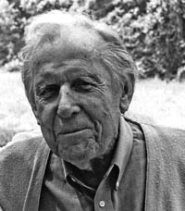
The human impact
  “Our ultimate failure as human beings
        is to become not a crowning glory
        of the earth,
            but the instrument of its degradation.”
            - Thomas Berry

Slide 5
Four perspectives
    ■ Biblical: Dominion over every living thing

Slide 6
Four perspectives
    ■ Biblical: Dominion over every living thing
    ■ Medieval: Escape from the world

Slide 7
Four perspectives
    ■ Biblical: Dominion over every living thing
    ■ Medieval: Escape from the world
    ■ Modern economic: Exploiting resources regardless

Slide 8
Four perspectives
    ■ Biblical: Dominion over every living thing
    ■ Medieval: Escape from the world
    ■ Modern economic: Exploiting resources regardless
    ■ Modern environmental: A mutually beneficial relationship with the earth

Slide 9
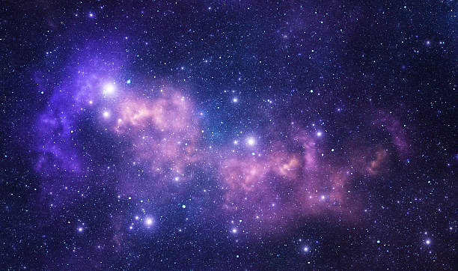
A new story of origins

Slide 10
A new story of origins
■ We’re products of stardust and time

Slide 11
A new story of origins
      ■ We’re products of stardust and time
      ■ ALL to be nurtured

Slide 12
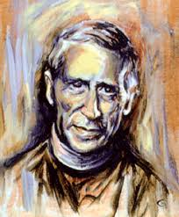
A new story of origins
      ■ Products of stardust and time
      ■ ALL to be nurtured
      ■ The noosphere

Slide 13
  How should we humans live upon the earth
      so that our presence enhances not just ourselves,
        but the planet itself?

Slide 14
Christian response
    ■ Stewardship

Slide 15
Christian response
    ■ Stewardship
    ■ Greening the churches

Slide 16
Christian response
    ■ Stewardship
    ■ Greening the churches
    ■ Accept the responsibility of human power

Slide 17
        Extinction?

Slide 18
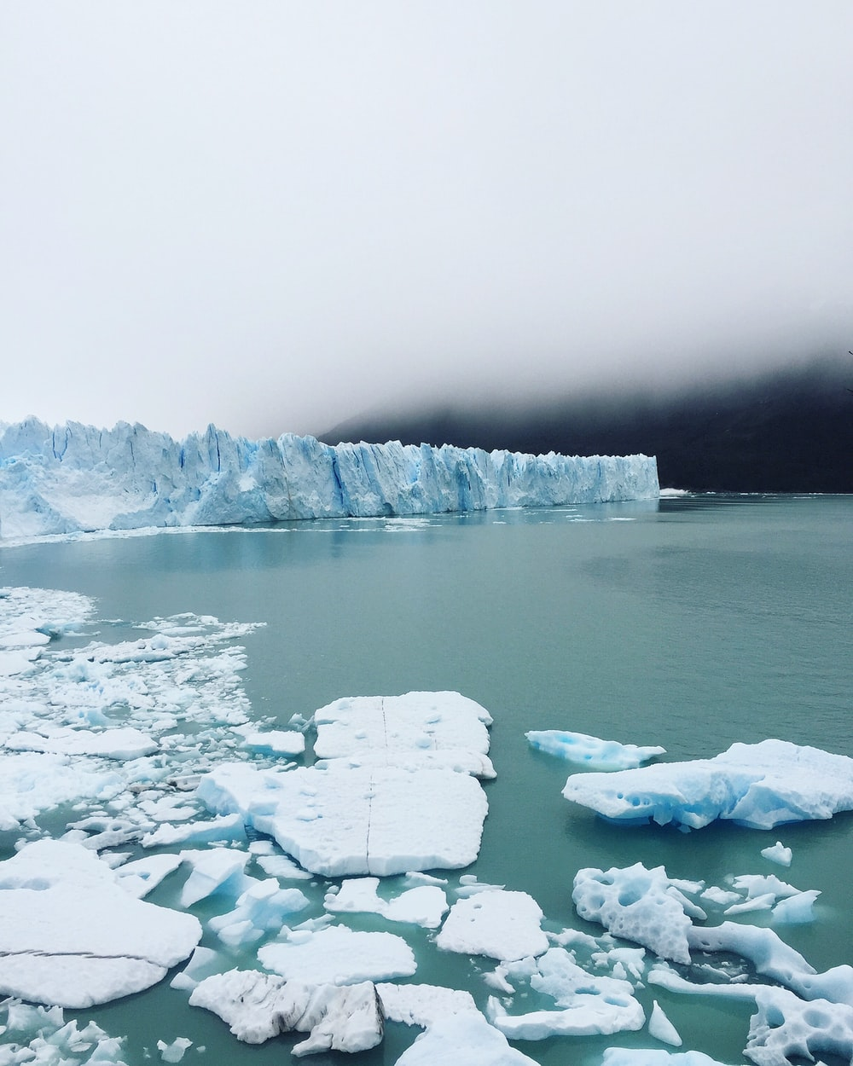

Slide 19
A world on the brink

Slide 20
    “Religion is a total mode
    of the interpreting
    and living
    of life.”
    - Carlo Della Casa

Slide 21
      Soul >

Slide 22
      Soul >
      Society >

Slide 23
      Soul >
      Society >
      Earth

Slide 24
Approach and Lifestyle

Slide 25
Human
> Eco-human

Slide 26
Wisdom of the Omaha . . .

Slide 27
Wisdom of the Omaha . . .
Baptism?

Slide 28
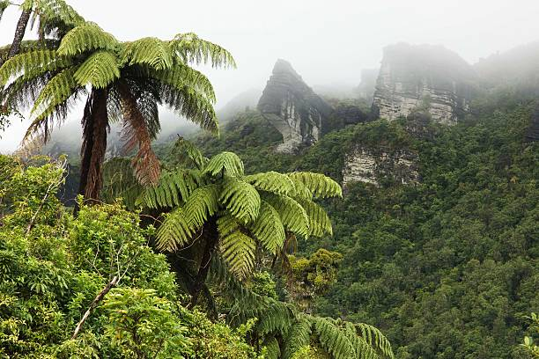
Te Urewera

Slide 29
Te Urewera
Mana, mauri . .
“the perception of a living
and spiritual force
in the forest”

Slide 30
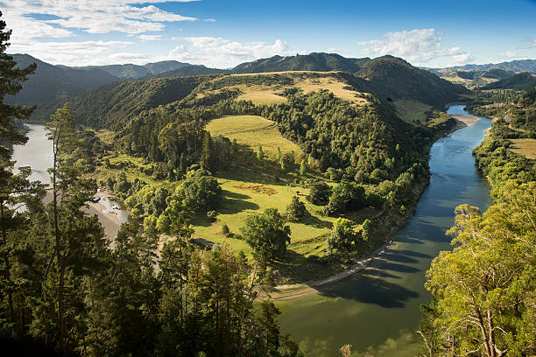
Te Awa Tupua
Whanganui River

Slide 31
Te Awa Tupua
“an indivisible and living whole . . . incorporating the river
and all of its physical
and metaphysical elements.”

Slide 32
“A dynamic, living system . . . ”

Slide 33
“A dynamic, living system . . . ”
    “A mauri . . . ”

Slide 34
Animism???
No!

Slide 35
A new balance . . .

Slide 36
                ■ Baptism

Slide 37
                ■ Baptism
                ■ Trinity

Slide 38
                ■ Baptism
                ■ Trinity
                ■ Hymns

Slide 39
                ■ Baptism
                ■ Trinity
                ■ Hymns
                ■ Theology

Slide 40
                ■ Baptism
                ■ Trinity
                ■ Hymns
                ■ Theology
                ■ Rituals

Slide 41
                ■ Baptism
                ■ Trinity
                ■ Hymns
                ■ Theology
                ■ Rituals
                ■ Contemplation

Slide 42
A new balance
to renew our participation in

Slide 43
the Grand Liturgy of the Universe

Slide 44
///

